Slide 1
JavaFX in Action
Paweł Gawędzki
2025-05-07
After Dark Bites & Bytes

Slide 2
What is JavaFX?
Architecture
FXML - Scene Builder
Events - Properties - Listeners
Property binding
Background processing
CSS – Transformation – Animation
Frameworks
Action & Q & A
Java concurrent

Slide 3
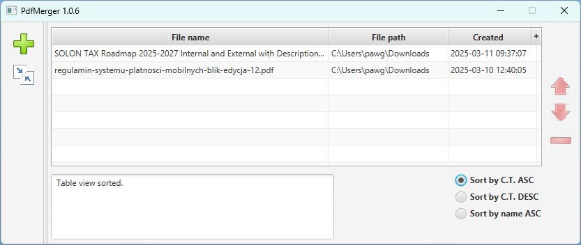
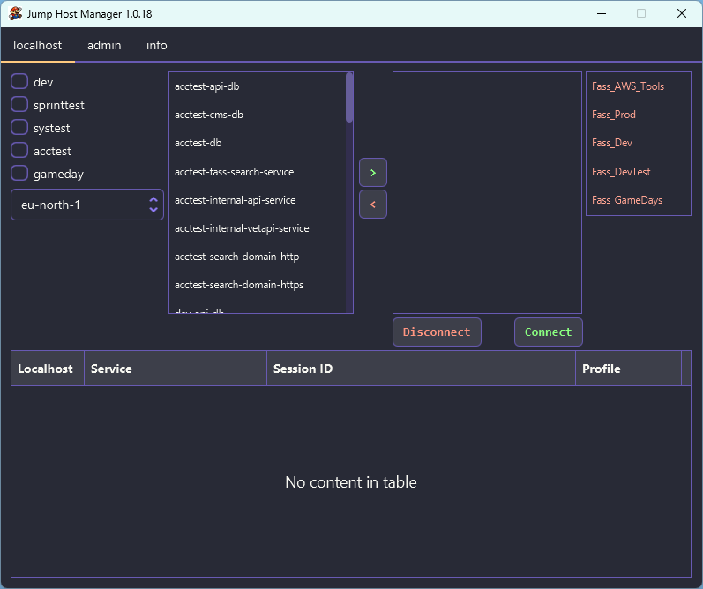
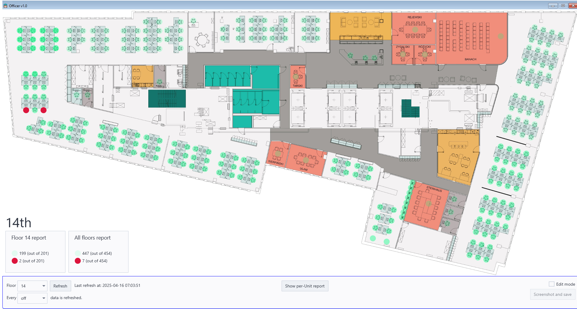
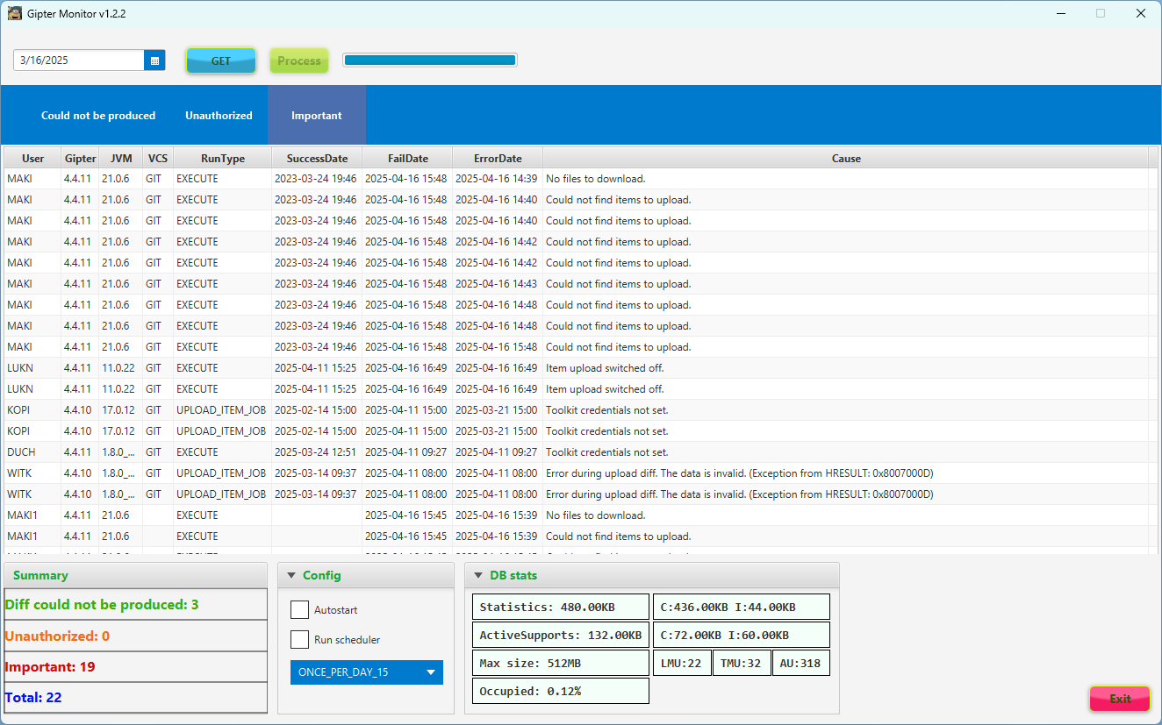
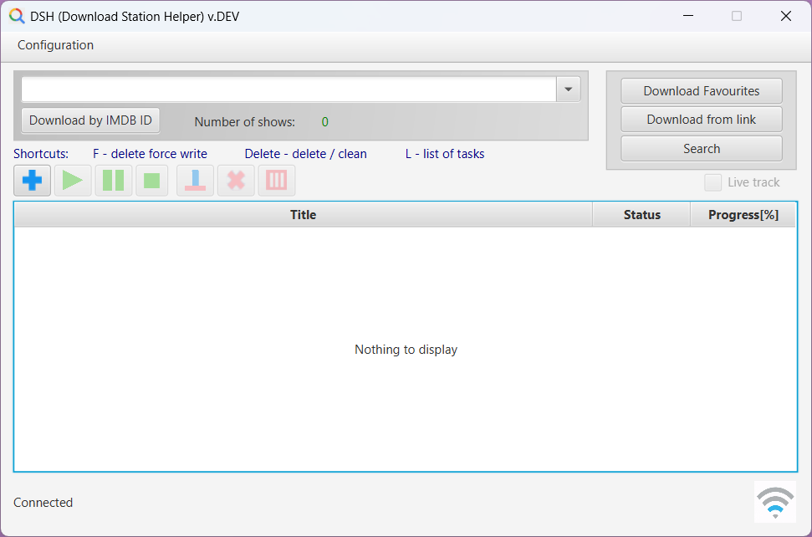
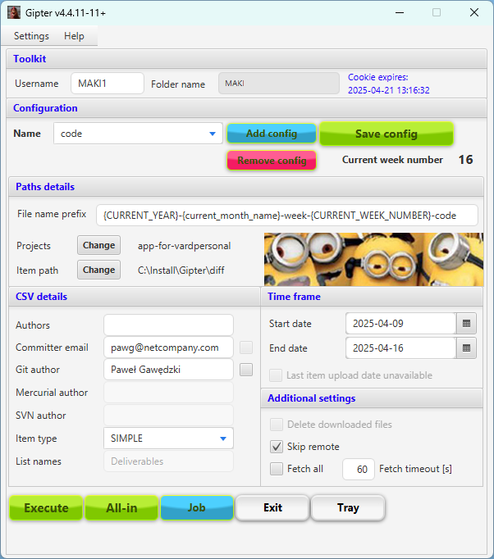
Paweł Gawędzki
Programming since 2008 (university time is not included)
Netcompany since 2017
Java star system, JVM planet
“Elegant JavaFX” article on DZone
JavaFX applications (… 99, DSH, PdfMerger, Gipter, monitor, jump-host, officer)

Slide 4
What is JavaFX?
Architecture
FXML - Scene Builder
Events – Properties - Listeners
Property binding
Background processing
CSS – Transformation – Animation
Frameworks
Action & Q & A
Java concurrent

Slide 5
What is JavaFX?
Announced May 2007
Preview end of July 2008, release December 2008
October 10, 2011, JavaFX 2.0
JavaFX 11 was first shipped in September 2018 (no longer bundled with JDK, openjfx.io Gluon).
Allows building GUI with windows/frames.
AWT, Swing, JavaFX, Eclipse SWT (DBeaver).
Notes:
SWT Standard Widget Toolkit

Slide 6
What is JavaFX?
Architecture
FXML – Scene Builder
Events – Properties - Listeners
Property binding
Background processing
CSS – Transformation – Animation
Frameworks
Action & Q & A
Java concurrent

Slide 7
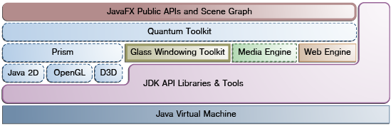
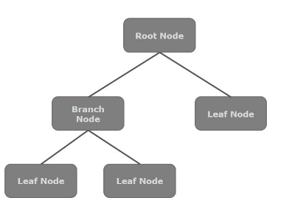
Architecture
JavaFX public APIs
Scene Graph - starting point for constructing a JavaFX application
Hierarchical tree of nodes that represents all of the visual elements of the application's user interface.
It can handle input and can be rendered.
Quantum Toolkit – graphics system, engine that runs JavaFX code.
Prism - JavaFX high performance graphics engine.
Glass Window Toolkit - a small and efficient windowing system, the platform-dependent layer that connects the JavaFX platform to the native operating system.
Media engine - supports both visual and audio media.
Web engine - based on Webkit, that provides a Web viewer and full browsing functionality through its API.

Slide 8
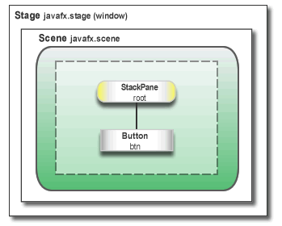
Window – Stage – Scene
Window is Stage
Stage contains Scene
Scene (container) consists of Controls

Slide 9
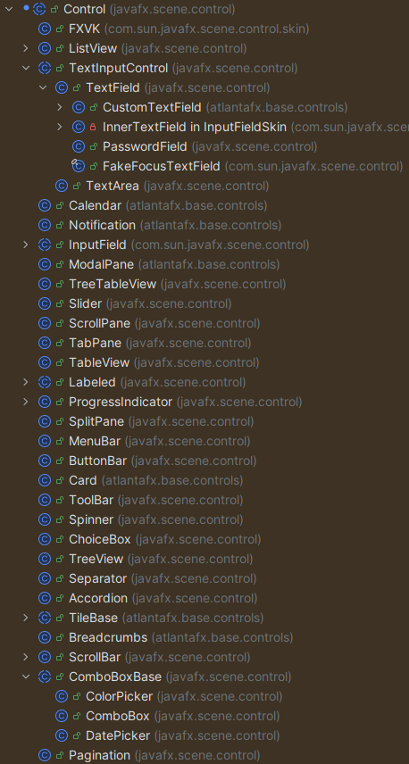
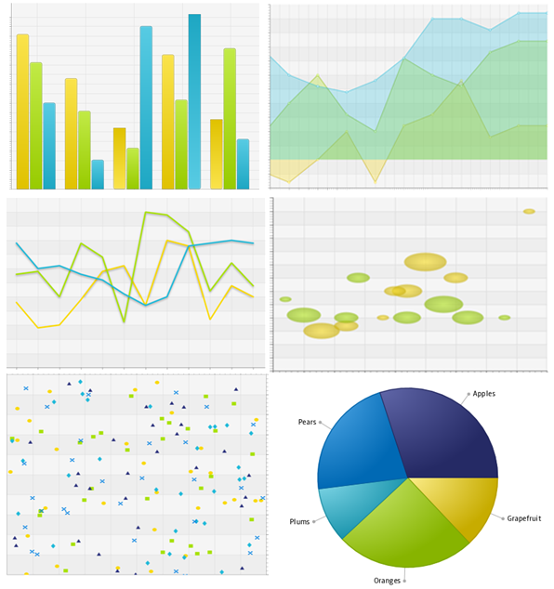
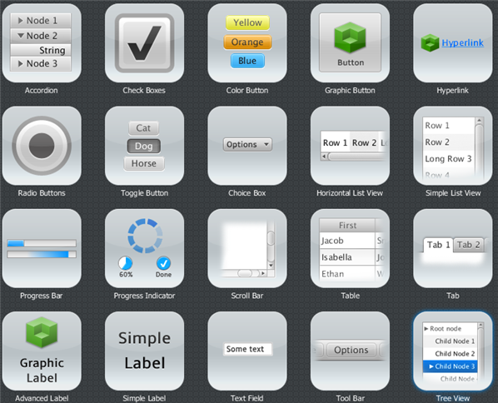
UI Controls
Layout (AnchorPane, TitledPane, Vbox, Hbox, FlowPane, GridPane …)
Action based (Button, ListView, TextField …)
Charts

Slide 10
What is JavaFX?
Architecture
FXML - Scene Builder
Events – Properties - Listeners
Property binding
Background processing
CSS – Transformation – Animation
Frameworks
Action & Q & A
Java concurrent

Slide 11
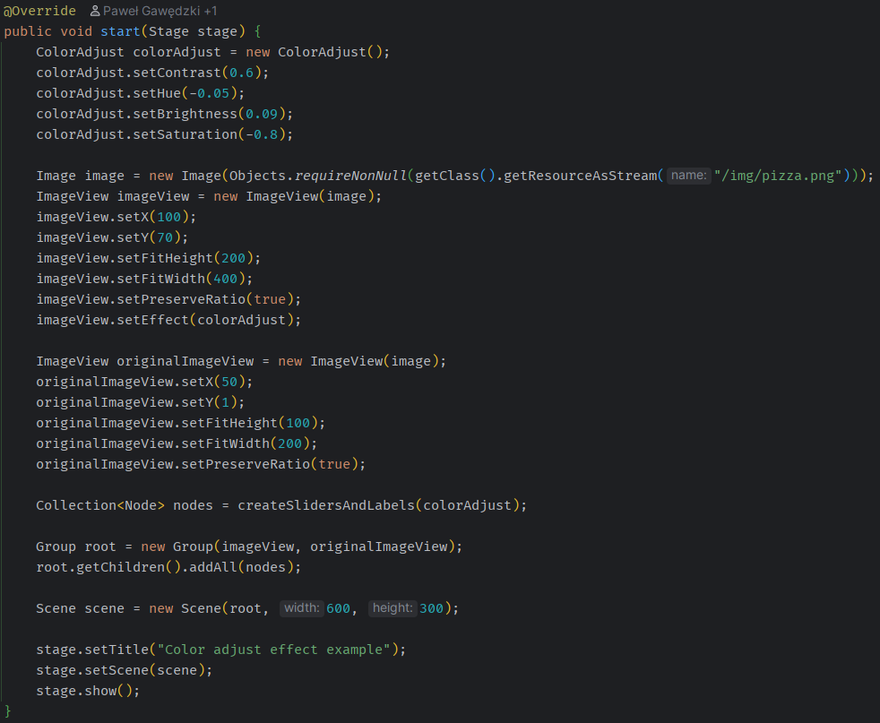
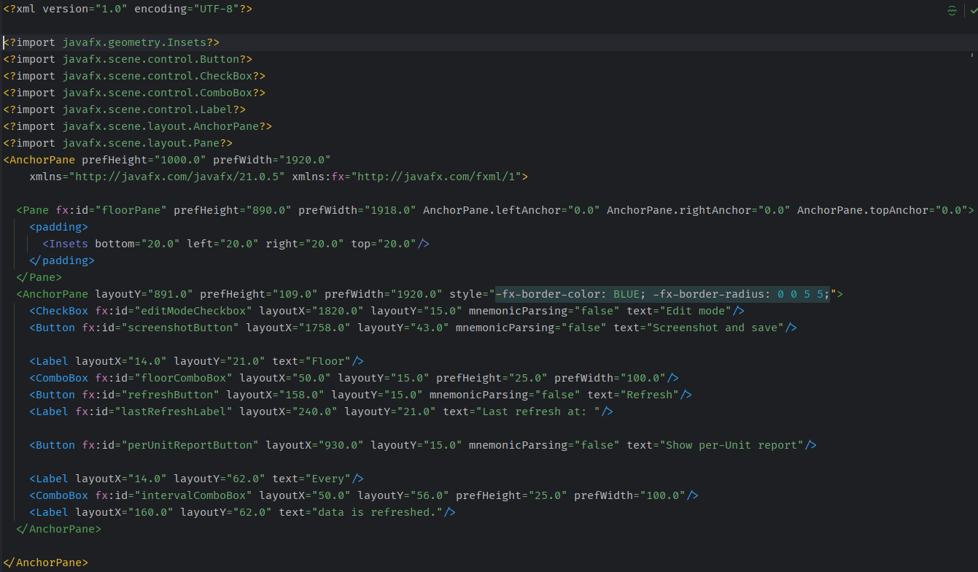
FXML
How can one define a form?
Programmatically
FXML format

Slide 12
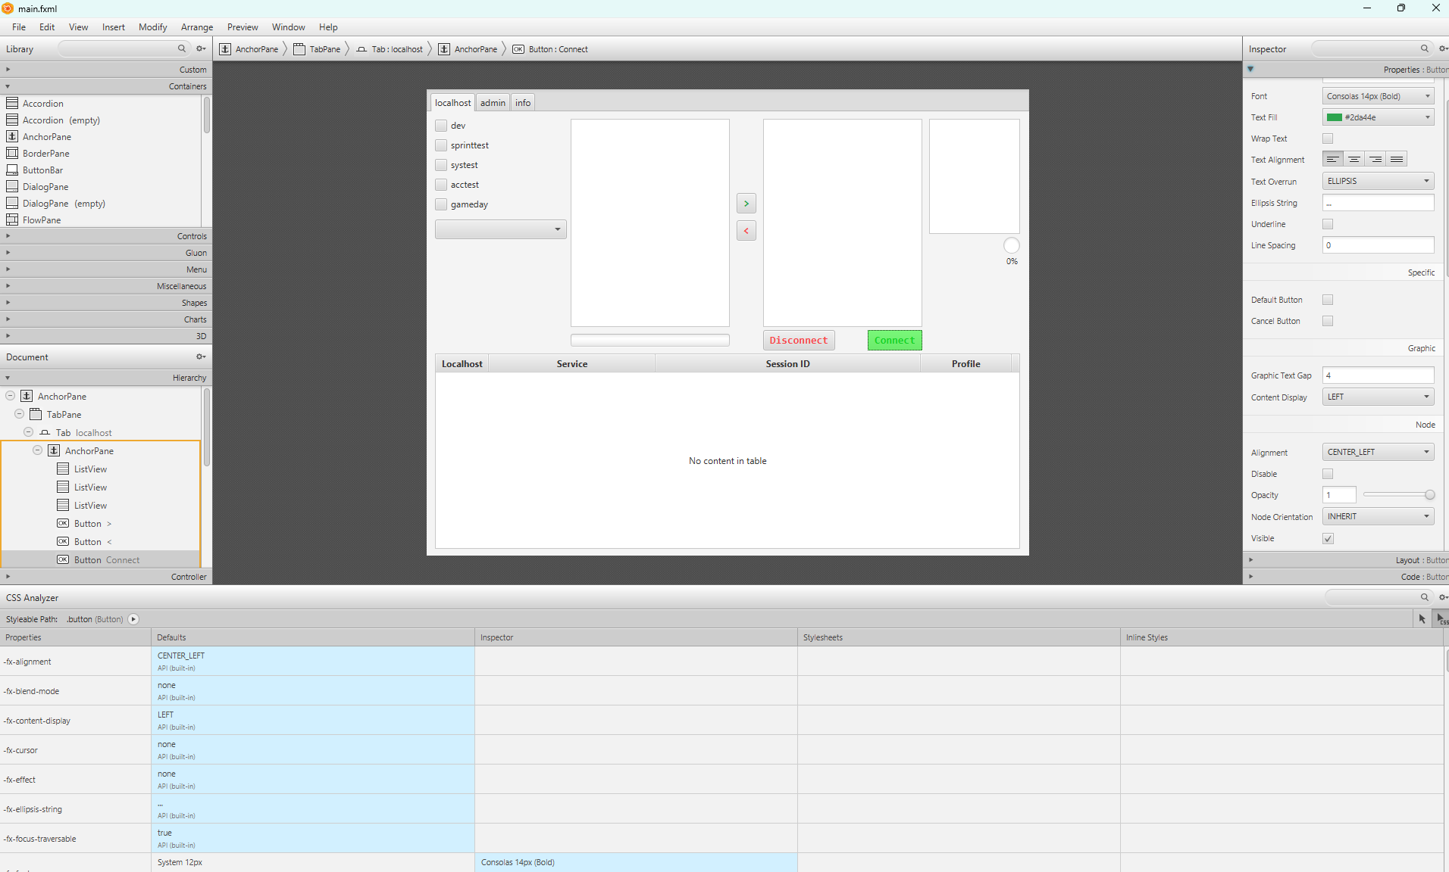
Scene Builder
C’mon? XMLs? Seriously?!!
Scene Builder

Slide 13
What is JavaFX?
FXML - Scene Builder
Window – Stage – Scene – Controls
Events - Properties - Listeners
Property binding
Background processing
CSS – Transformation – Animation
Frameworks
Action & Q & A
Java concurrent

Slide 14
Events
User Action | Event Type | EventHandler Properties
Pressing, releasing, or typing a key on keyboard. | KeyEvent | onKeypressed, onKeyReleased, onKeyTyped
Moving, Clicking, or dragging the mouse. | MouseEvent | onMouseClicked, onMouseMoved onMousePressed, onMouseReleased onMouseEntered, onMouseExited
Pressing, Dragging, and Releasing of the mouse button. | MouseDragEvent | onMouseDragged, onMouseDragEntered onMouseDragExited, onMouseDragged onMouseDragOver, onMouseDragReleased
Generating, Changing, Removing or Committing input from an alternate method. | InputMethodEvent | onInputMethodTextChanged
Performing Drag and Drop actions supported by the platform. | DragEvent | onDragDetected, onDragDone, onDragDropped onDragEntered, onDragExited, onDragOver
Scrolling an object. | ScrollEvent | onScroll, onScrollStarted, onScrollFinished
Rotating an object. | RotateEvent | onRotate, onRotationFinished, onRotationStarted
Swiping an object upwards, downwards, to the right and left. | SwipeEvent | onSwipeUP, onSwipeDown, onSwipeLeft, onSwipeRight
Touching an object. | TouchEvent | onTouchMoved, onTouchReleased, onTouchStationary
Zooming on an object. | ZoomEvent | onZoom, onZoomStarted, onZoomFinished
Requesting Context Menu. | ContextMenuEvent | onContextMenuRequested
Pressing a button, showing or hiding a combo box, selecting a menu item. | ActionEvent
Editing an item. | ListView.EditEvent, TableColumn.CellEditEvent, TreeView.EditEvent
Encountering an error in a media player. | MediaErrorEvent
Showing or Hiding Menu, Hiding a pop-up window, Selecting or Closing a Tab | Event
Showing, Minimizing, or Closing a Window. | WindowEvent
Event is an outcome of an action.
Action can be (pressing, clicking, scrolling, rotating, touching, dragging …).
Event types (mouse, key, drag, window).
Pulse is an event that indicates to the JavaFX scene graph that it’s time to synchronize the state of the elements on the scene graph with Prism
is throttled at 60 frames per second (fps) maximum
fired whenever animations are running on the scene graph
is scheduled when something in the scene graph is changed
Glass Windowing Toolkit is responsible for executing the pulse events

Slide 15
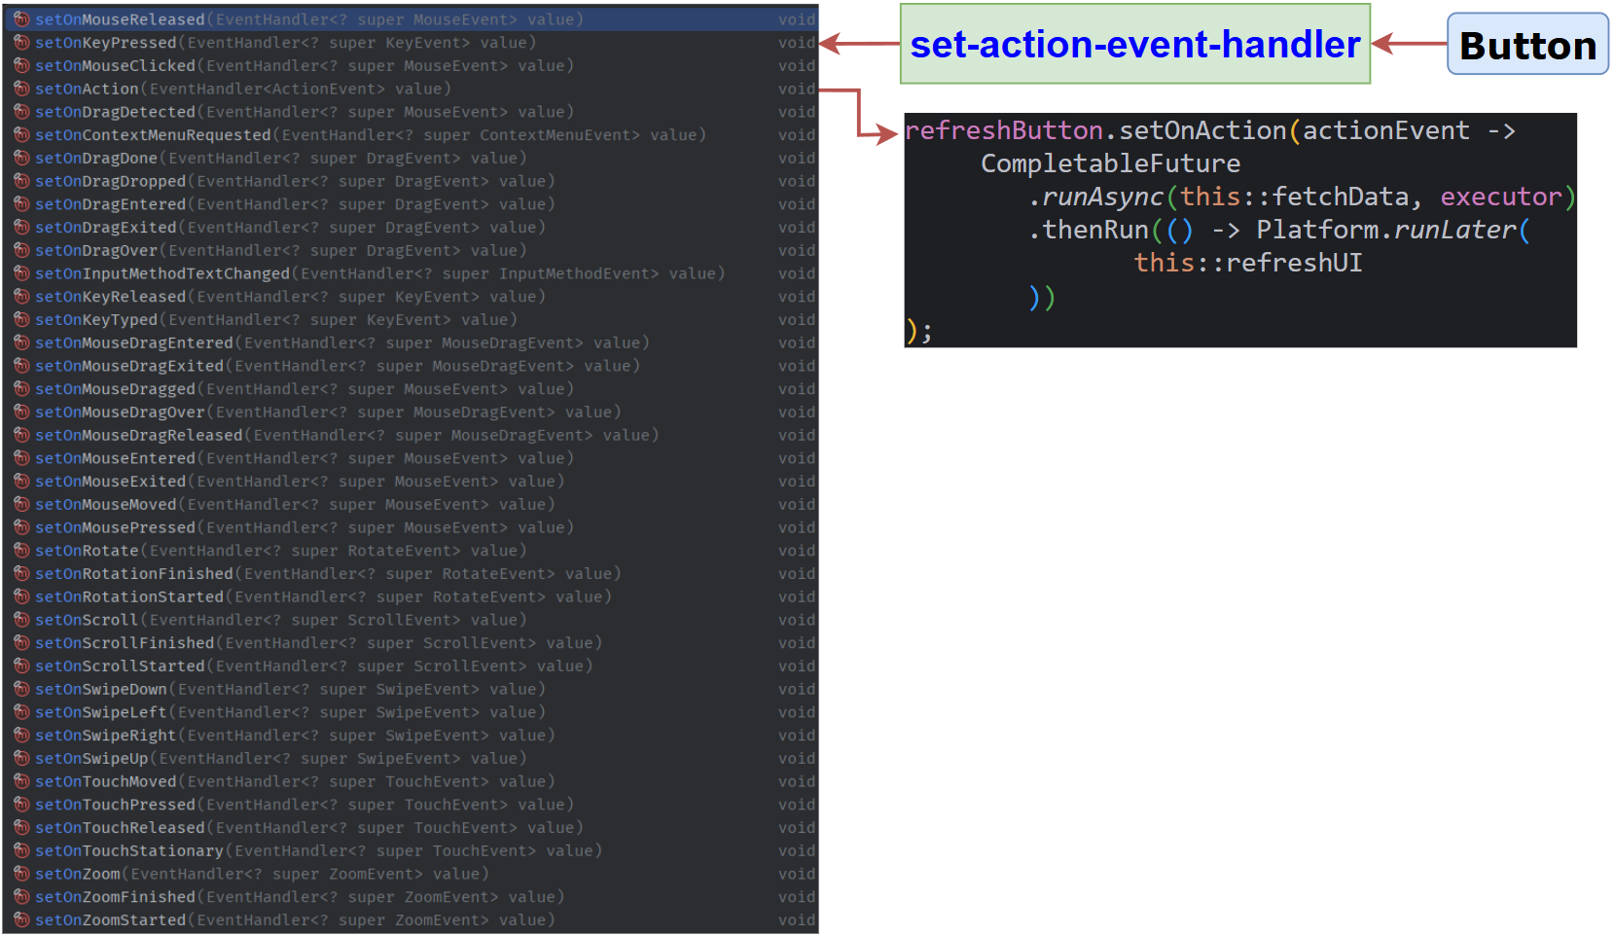
Events

Slide 16
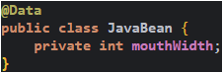
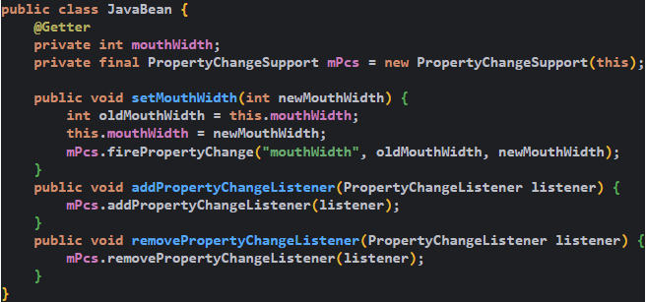
Properties
Property model - JavaBeans component architecture.
Properties of a bean are the things you can change that affect internal state or its appearance.
A bound property notifies listeners when its value changes.
Constrained property – veto listeners stops the change.

Slide 17
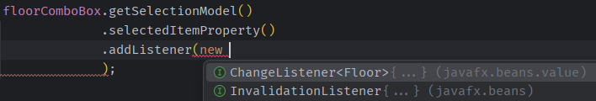
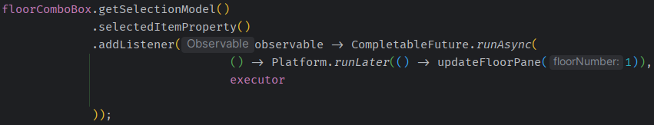
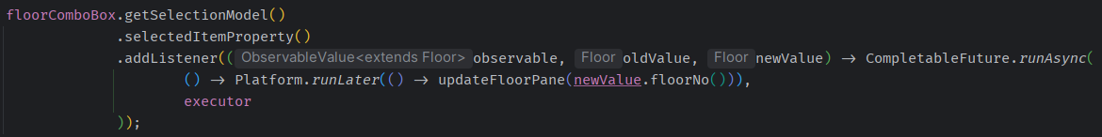
Listeners
Properties are the things you can change that affect its appearance or internal state.
Properties implement Observable and ObservableValue interfaces.
Add a listener to a property.
When property changes, listener is executed.
InvalidationListener and ChangeListener

Slide 18
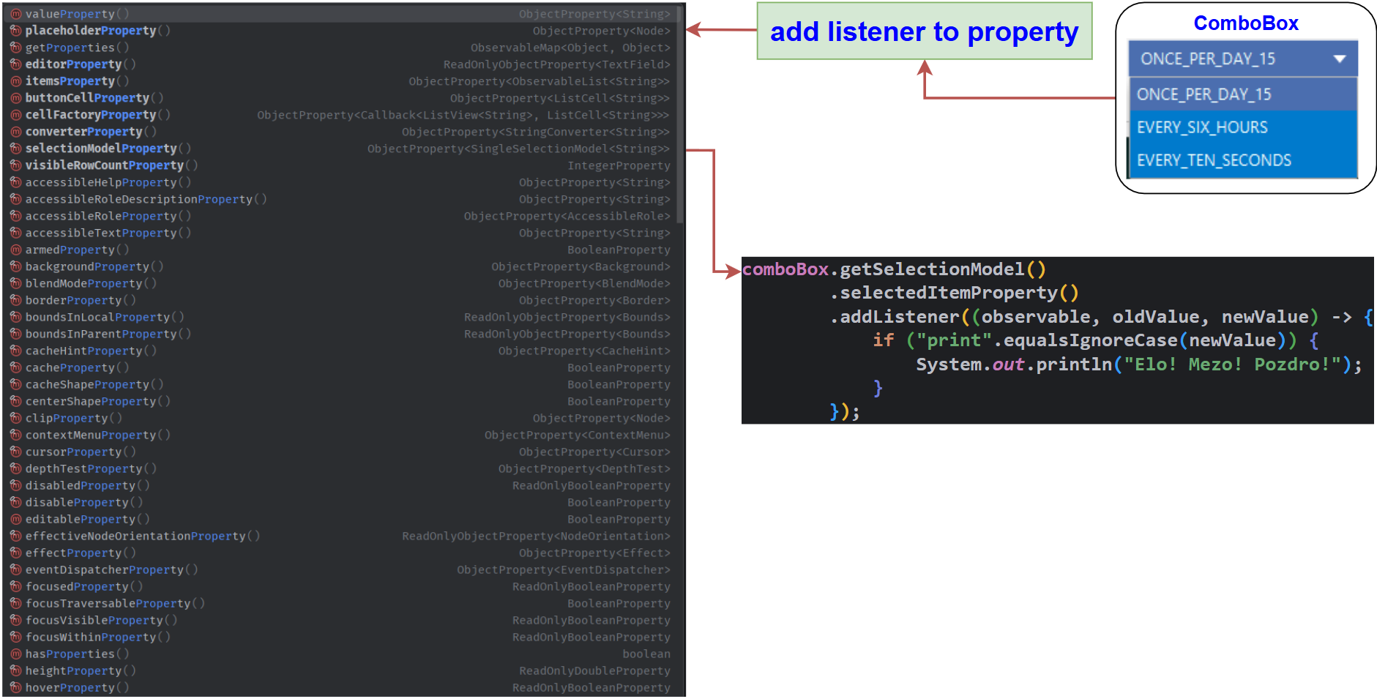
Properties - Listeners

Slide 19
What is JavaFX?
FXML + Scene Builder
Window – Stage – Scene – Controls
Events + Listeners
Property binding
Background processing
CSS – Transformation – Animation
Frameworks
Action & Q & A
Java concurrent

Slide 20
Property binding
Very handy when changes in UI should be reflected in business logic.
High-Level Binding API
Low-Level Binding API
Uni- and bi-directional binding
Unidirectional -> label.textProperty().bind(textField.textProperty())
Bidirectional -> textField.textProperty().bindBidirectional(bean.nameProperty())
Additional mapping activity is need when persisting data (or earlier)
Gson a custom TypeAdapter
Use FX Gson (https://github.com/joffrey-bion/fx-gson)
@Entity have not tried yet
Notes:
GSON doesn't respect encapsulation, and tries to replicate your fields instead of your properties (and it appears there's no equivalent to JPA's "field access" versus "property access" functionality, nor any desire to provide it).
Using Jackson the serialized version is generated via properties, and would look the way you want it directly out of the box:

Slide 21
What is JavaFX?
FXML + Scene Builder
Window – Stage – Scene – Controls
Events + Listeners
Property binding
Background processing
CSS – Transformation – Animation
Frameworks
Action & Q & A
Java concurrent

Slide 22
Background processing
Scene graph - is not thread-safe.
Scene graph can only be accessed and modified from the JavaFX Application thread.
At the system level, the JVM creates separate threads for running and rendering the application.
Application thread – a primary thread of any JavaFX application. All the live nodes and components are attached to this thread.
Prism render thread – responsible for rendering the Scene Graph separately.
Media thread - runs in the background and synchronizes the latest frames through the scene graph by using the JavaFX application thread.
Long-running tasks on the JavaFX Application thread inevitably make an application UI unresponsive.
A best practice is to do long-running tasks on one or more background threads and let the JavaFX Application thread process user events.
Create Runnable (or Callable) and run it in a new thread.
More flexibility, but is error-prone.
Use javafx.concurrent package, which takes care of multithreaded code that interacts with the UI and ensures that this interaction happens on the correct thread.
https://docs.oracle.com/javafx/2/threads/jfxpub-threads.htm

Slide 23
Background processing – Task class
Enables developers to implement asynchronous tasks in JavaFX applications.
Inherits from the java.utils.concurrent.FutureTask (Runnable) class, internally uses Callable.
You can call it directly by using the FutureTask.run() method, which enables calling this task from another background thread.
Can be used within the Java concurrency Executor API.
Can be passed to a thread as a parameter.
Method call can only manipulate states that are safe to read and write from a background thread.
Manipulating an active scene graph from the call method throws runtime exceptions.
Inside the call method, you can use the updateProgress, updateMessage, updateTitle methods.
The above methods update the values of the corresponding properties on the JavaFX Application thread.
It defines a one-time object that cannot be reused. If you need a reusable object, use the Service class.
Having a good understanding of the Java concurrency API will help you understand concurrency in JavaFX.

Slide 24
Background processing – Service class
The purpose of this class is to help the developer to implement the correct interaction between the background threads and the JavaFX Application thread.
Is designed to execute a Task object on one or several background threads.
Class methods and states must only be accessed on the JavaFX Application thread.
You can start, cancel and restart (Worker).
You can observe the state of the background work and optionally cancel it.
Later, you can reset the service and restart it. Thus, the service can be defined declaratively and restarted on demand.
Can be executed in one of the following ways:
by a custom Executor object, if it is specified for the given service,
by a daemon thread, if no executor is specified.
If no executor is specified then the default executor is a ThreadPoolExecutor.

Slide 25
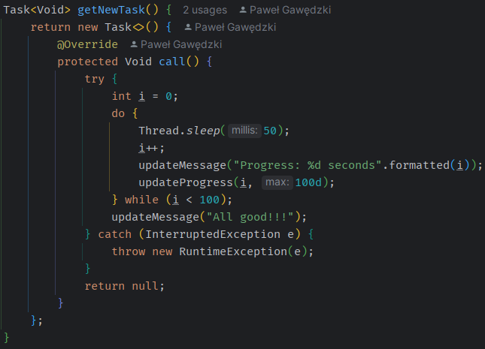
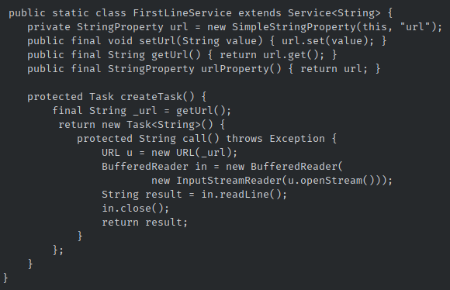
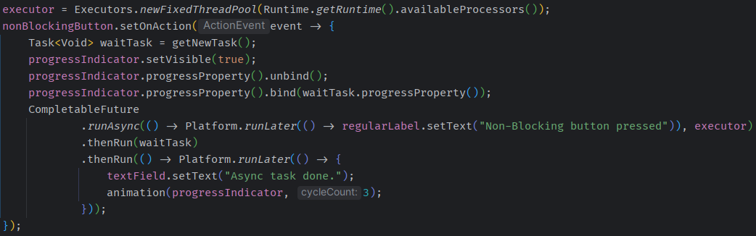
Background processing – example

Slide 26
What is JavaFX?
Architecture
FXML + Scene Builder
Events + Listeners
Property binding
Background processing
CSS – Transformation – Animation
Frameworks
Action & Q & A
Java concurrent

Slide 27
CSS – Transformation - Animation
JavaFX CSS customize styling to the UI without changing any of application's source code.
Transformations are modifications to visual representation of nodes allowing to achieve effects like:
translation
rotation
scaling
shearing
Animation - creating illusion of its motion by rapid display, it’s used to visually enhance an application.
Animations are used in an application to add certain special visual effects on elements
Fade Transition, Fill Transition, Rotate Transition, Scale Transition, Stroke Transition, Translate Transition, Path Transition, Sequential Transition, Pause Transition, Parallel Transition

Slide 28
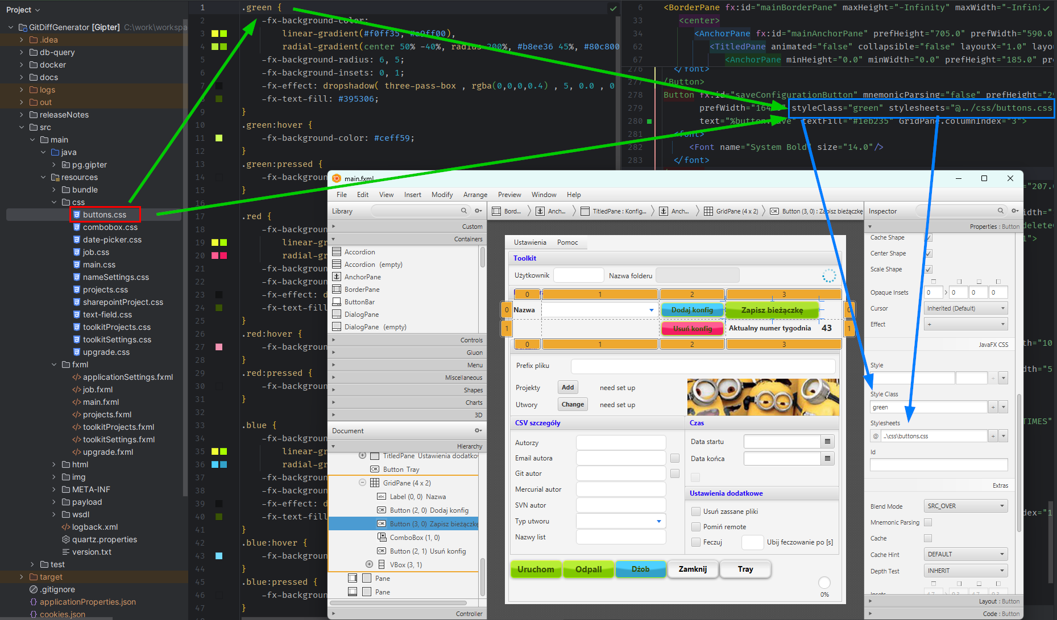
CSS
JavaFX CSS:
can be applied to any node in the scene graph,
are applied to the nodes asynchronously,
can be easily assigned to the scene at runtime, allowing an application's appearance to dynamically change,
is based on the W3C CSS,
allow to be parsed cleanly by any compliant CSS parser,
enables the mixing of CSS styles for JavaFX and for other purposes (such as for HTML pages) into a single style sheet,
all JavaFX property names are prefixed with a vendor extension of ”-fx-”
JavaFX CSS Reference Guide:
https://docs.oracle.com/javafx/2/api/javafx/scene/doc-files/cssref.html
https://eugener.github.io/javafx-css/

Slide 29
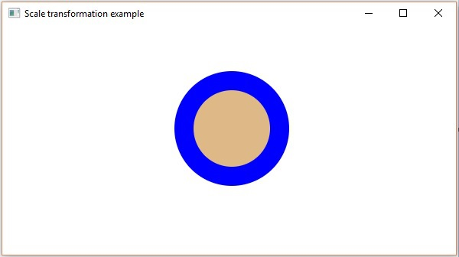
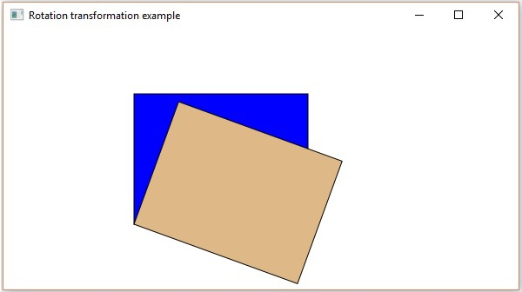
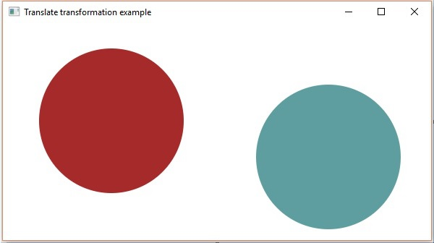
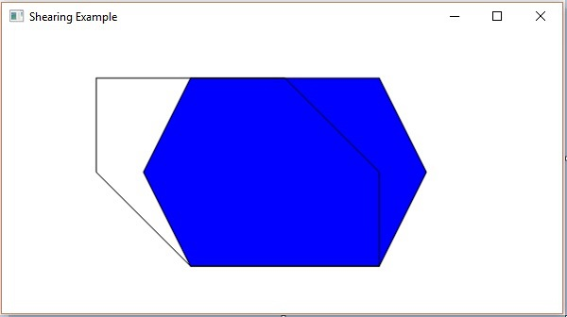
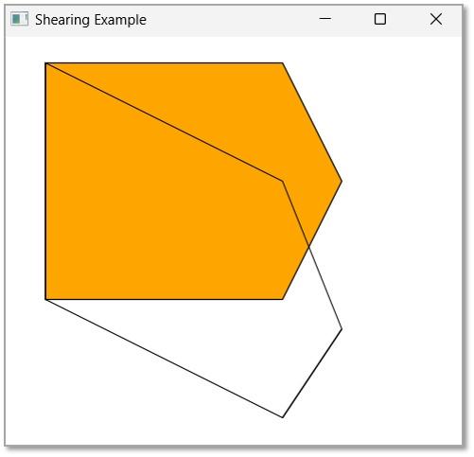
Transformation

Slide 30
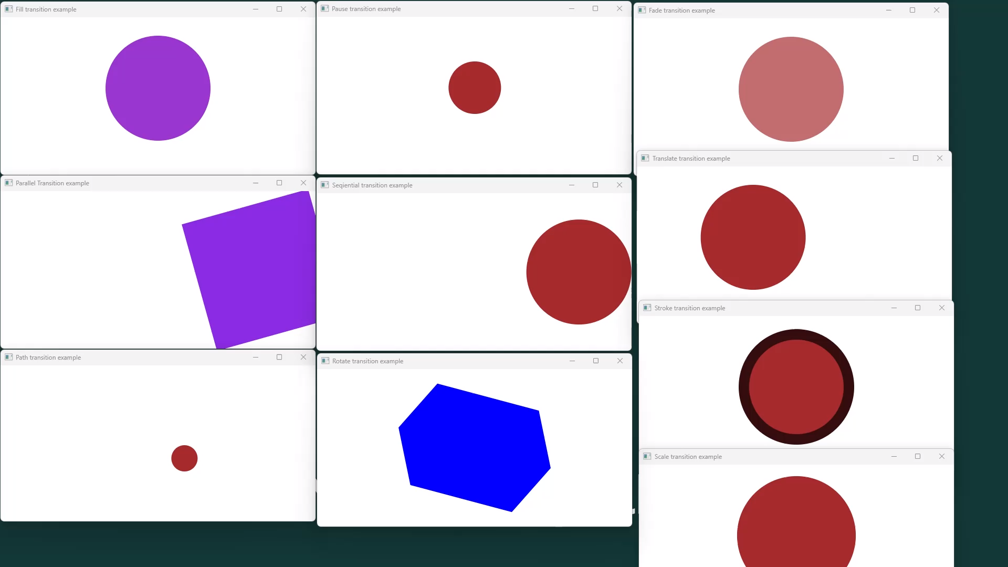
Animation

Slide 31
What is JavaFX?
Architecture
FXML + Scene Builder
Events + Listeners
Property binding
Background processing
CSS – Transformation – Animation
Frameworks
Action & Q & A
Java concurrent

Slide 32
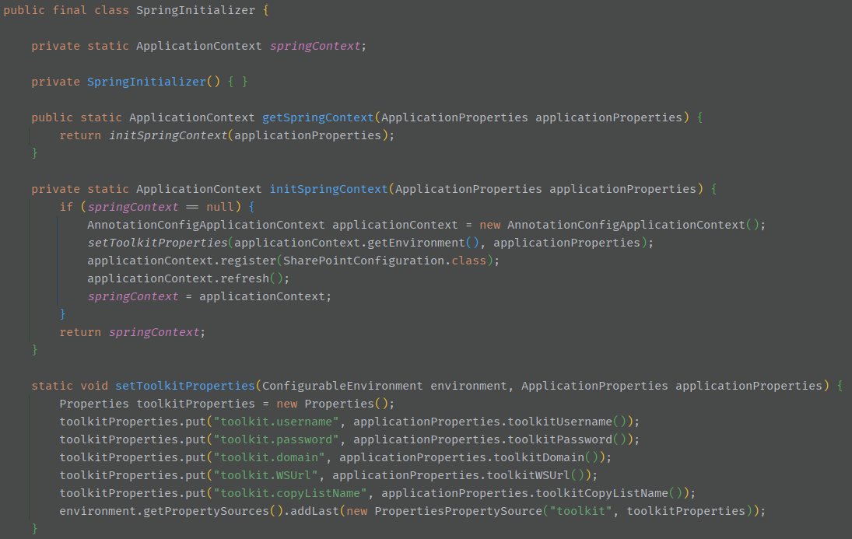
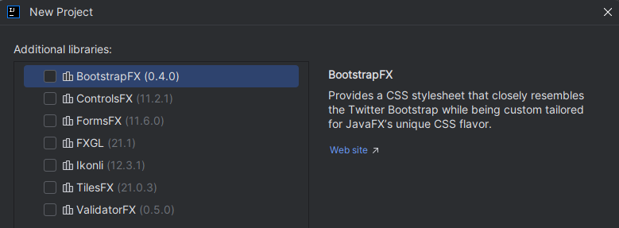
Frameworks
Not many known to me.
AtlantaFX – themes.
TestFX – UI testing.
ControlsFX – additional controls.
More:
https://gluonhq.com/products/gluonfx/
https://openjfx.io/
What about Spring?

Slide 33
What is JavaFX?
Architecture
FXML + Scene Builder
Events + Listeners
Property binding
Background processing
CSS – Transformation – Animation
Frameworks
Action & Q & A
Java concurrent

Slide 34
The most common mistakes according to AI
Cortex: file:///C:/Users/pawg/OneDrive%20-%20Netcompany/Documents/JavaFX/commons-problems-for-beginners-cortex.html
Deep Seek: file:///C:/Users/pawg/OneDrive%20-%20Netcompany/Documents/JavaFX/common-problems-for-beginners-deepseek.html

Slide 35
Where to start?
https://docs.oracle.com/javase/8/javafx/get-started-tutorial/get_start_apps.htm
https://openjfx.io/#community
https://docs.oracle.com/javase/8/javafx/get-started-tutorial/get_start_apps.htm
https://gluonhq.com/
https://docs.oracle.com/javafx/2/threads/jfxpub-threads.htm
https://docs.oracle.com/javafx/2/binding/jfxpub-binding.htm
https://docs.oracle.com/javase/8/javafx/properties-binding-tutorial/binding.htm
https://docs.oracle.com/javase/8/javase-clienttechnologies.htm
https://dzone.com/articles/the-bean-class-for-javafx-programming
https://github.com/TestFX/TestFX
https://mkpaz.github.io/atlantafx/
https://controlsfx.github.io/
https://www.tutorialspoint.com/javafx/index.htm
https://www.jpro.one/
https://dzone.com/articles/20-examples-of-using-javas-completablefuture
https://dzone.com/articles/java-8-definitive-guide
https://dzone.com/articles/exception-handling-in-java-completablefuture

Slide 36
Bonus
Java Swing | JavaFX
Swing is the standard toolkit for Java developers in creating GUI | JavaFX grants platform assistance for designing desktop applications.
Swing has a further refined collection of GUI components | JavaFX has a fair amount of UI components available but is more inferior to what Swing provides.
Swing is a legacy library that fully features and provides pluggable UI components | JavaFX has UI components that are still growing with a further advanced look and feel.
Swing can implement UI components with a conventional look and feel. | JavaFX can provide rich internet applications having a modern UI.
Swing-related classes can be found in the Java API guide with complete documentation | JavaFX doc is available in various formats with comprehensive detailing and file support.
Swing is an advent in nature. Hence, it can produce UI components using conventional Java component classes | Java FX originally uses a declarative language called JavaFX Script.
Swing has a UI component library and acts as a legacy | JavaFX has several components built over Swing.
Swing has assistance for MVC, but it is not uniform across a component. | JavaFX support is really favorable with MVC.
Swing has various IDEs, which offer a tool for rapid development. | JavaFX has also support from numerous IDEs as well, but it is not as experienced as Swing.
A swing was renamed from Java Foundation Classes, and sun microsystems announced it in the year 1997 | JavaFX was initially released in December 2008 by Sun microsystem, later acquired by Oracle, now under Gluon care and development.
Events in Swing aren’t that consistent | Events in JavaFX are higher thought-out and additional consistent than their equivalents in Swing.
Swing lacks any support for modern touch devices. | JavaFX has fundamental maintenance for signature gestures resembling scrolling, swiping, rotating, and zooming.
Swing has basic controls like buttons, checkboxes, and bandboxes. | JavaFX has many eye-catching controls that Swing doesn’t have

Slide 37
What is JavaFX?
Architecture
FXML + Scene Builder
Events + Listeners
Property binding
Background processing
CSS – Transformation – Animation
Frameworks
Action & Q & A
Java concurrent

Slide 38
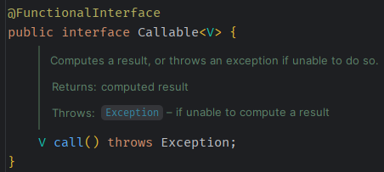
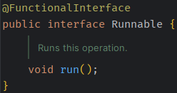
Java concurrent – Runnable, Callable
Runnable interface - represents an operation that does not return a result. This is a functional interface whose functional method is run().
Callable interface - a task that returns a result and may throw an exception.
Implementors define a single method with no arguments called call.
The Callable interface is similar to Runnable, in that both are designed for classes whose instances are potentially executed by another thread. A Runnable, however, does not return a result and cannot throw a checked exception.
The Executors class contains utility methods to convert from other common forms to Callable classes.

Slide 39
Java concurrent – Thread
A thread is a thread of execution in a program.
The Java virtual machine allows an application to have multiple threads of execution running concurrently.
Thread defines constructors and a Thread.Builder to create threads.
Starting a thread schedules it to execute its run method.
The newly started thread executes concurrently with the thread that caused it to start.
A thread terminates if either its run method completes normally, or if its run method completes abruptly and the appropriate uncaught exception handler completes normally or abruptly.
With no code left to run, the thread has completed execution.
The join method can be used to wait for a thread to terminate.
Threads have a unique identifier and a name.
The identifier is generated when a Thread is created and cannot be changed.
The thread name can be specified when creating a thread or can be changed at a later time.

Slide 40
Java concurrent – Platform Threads
Thread supports the creation of platform threads that are typically mapped 1:1 to kernel threads scheduled by the operating system.
Platform threads will usually have a large stack and other resources that are maintained by the operating system.
Platforms threads are suitable for executing all types of tasks but may be a limited resource.
Platform threads get an automatically generated thread name by default.
Platform threads are designated daemon or non-daemon threads.
When the Java virtual machine starts up, there is usually one non-daemon thread (the thread that typically calls the application's main method).
The shutdown sequence begins when all started non-daemon threads have terminated. Unstarted non-daemon threads do not prevent the shutdown sequence from beginning.
In addition to the daemon status, platform threads have a thread priority and are members of a thread group.

Slide 41
Java concurrent – Virtual Threads
Thread also supports the creation of virtual threads.
Virtual threads are typically user-mode threads scheduled by the Java runtime rather than the operating system.
Virtual threads will typically require few resources and a single Java virtual machine may support millions of virtual threads.
Virtual threads are suitable for executing tasks that spend most of the time blocked, often waiting for I/O operations to complete.
Virtual threads are not intended for long running CPU intensive operations.
Virtual threads typically employ a small set of platform threads used as carrier threads.
Locking and I/O operations are examples of operations where a carrier thread may be re-scheduled from one virtual thread to another.
Code executing in a virtual thread is not aware of the underlying carrier thread.
The currentThread() method, used to obtain a reference to the current thread, will always return the Thread object for the virtual thread.
Virtual threads do not have a thread name by default. The getName method returns the empty string if a thread name is not set.
Virtual threads are daemon threads and so do not prevent the shutdown sequence from beginning.
Virtual threads have a fixed thread priority that cannot be changed.

Slide 42
Java concurrent – Thread examples
Runnable runnable = ...
// Start a daemon thread to run a task
Thread thread = Thread.ofPlatform().daemon().start(runnable);
// Create an unstarted thread with name "duke", its start() method
// must be invoked to schedule it to execute.
Thread thread = Thread.ofPlatform().name("duke").unstarted(runnable);
thread.start();
// A ThreadFactory that creates daemon threads named "worker-0", "worker-1", ...
ThreadFactory factory = Thread.ofPlatform().daemon().name("worker-", 0).factory();
// Start a virtual thread to run a task
Thread thread = Thread.ofVirtual().start(runnable);
thread.startVirtualThread(runnable);
// A ThreadFactory that creates virtual threads
ThreadFactory factory = Thread.ofVirtual().factory();

Slide 43
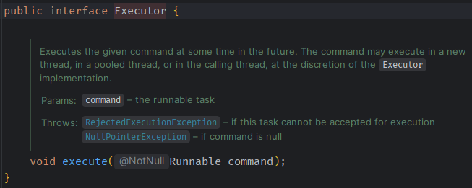
Java concurrent – Executor
An object that executes submitted Runnable tasks.
This interface provides a way of decoupling task submission from the mechanics of how each task will be run, including details of thread use, scheduling, etc.
An Executor is normally used instead of explicitly creating threads. Rather than invoking new Thread(new RunnableTask()).start() for each of a set of tasks, you might use executor.execute(new RunnableTask1())

Slide 44
Java concurrent – ExecutorService
ExecutorService implements Executor
An Executor that provides methods to manage termination and methods that can produce a Future for tracking the progress of one or more asynchronous tasks.
Two different methods are provided for shutting down an ExecutorService.
The shutdown method will allow previously submitted tasks to execute before terminating, while the shutdownNow method prevents waiting tasks from starting and attempts to stop currently executing tasks.
Upon termination, an executor has no tasks actively executing, no tasks awaiting execution, and no new tasks can be submitted.
An unused ExecutorService should be shut down to allow the reclamation of its resources.

Slide 45
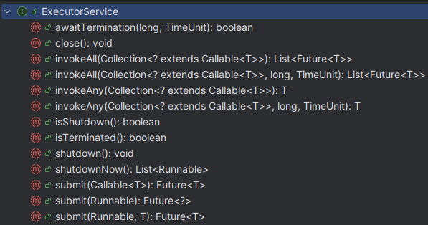
Java concurrent – ExecutorService

Slide 46
Java concurrent – Executors
Factory and utility methods for Executor, ExecutorService, ScheduledExecutorService, ThreadFactory, and Callable classes defined in this package.
This class supports the following kinds of methods:
Methods that create and return an ExecutorService set up with commonly useful configuration settings.
Methods that create and return a ScheduledExecutorService set up with commonly useful configuration settings.
Methods that create and return a "wrapped" ExecutorService, that disables reconfiguration by making implementation-specific methods inaccessible.
Methods that create and return a ThreadFactory that sets newly created threads to a known state.
Methods that create and return a Callable out of other closure-like forms, so they can be used in execution methods requiring Callable.

Slide 47
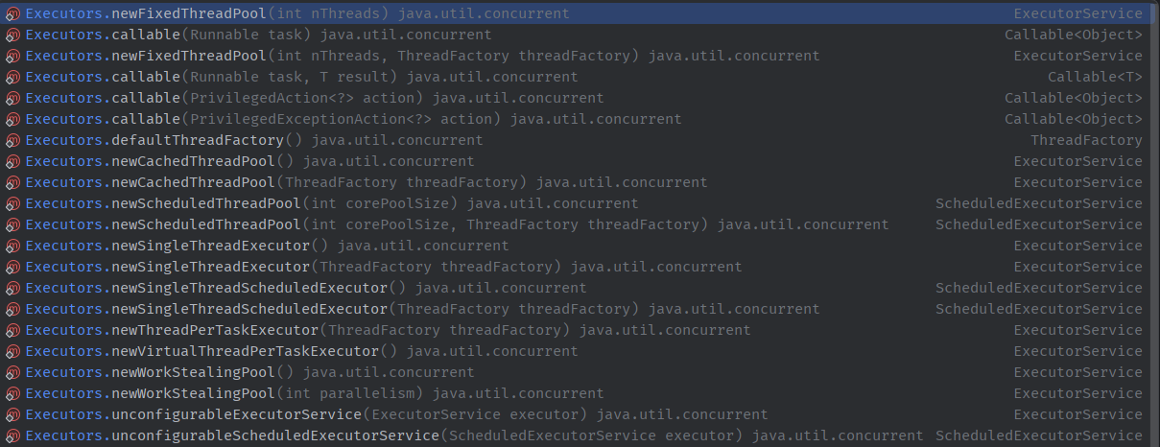
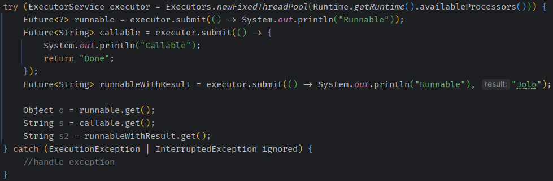
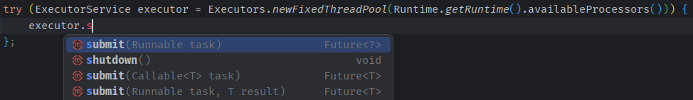
Java concurrent – Executors

Slide 48
Java concurrent - Future
A Future<> represents the result of an asynchronous computation.
Methods are provided to check if the computation is complete,
to wait for its completion,
to retrieve the result of the computation.
The result can only be retrieved using the method get when the computation has completed, blocking if necessary until it is ready.
Cancellation is performed by the cancel method.
Additional methods are provided to determine if the task was completed normally or was cancelled.
Once a computation has been completed, the computation cannot be cancelled.
If you would like to use a Future<> for the sake of cancellability but not provide a usable result, you can declare types of the form Future<?> and return null as a result of the underlying task.
The FutureTask<> class is an implementation of Future that implements Runnable, and so may be executed by an Executor.

Slide 49
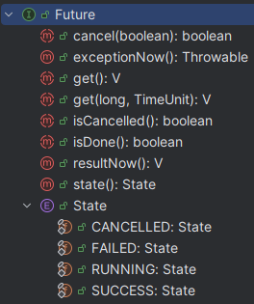
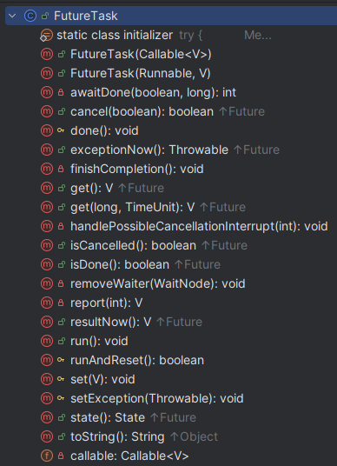
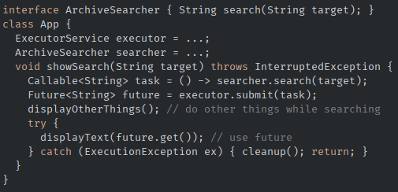
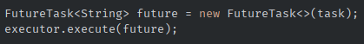
Java concurrent - Future

Slide 50
Java concurrent - CompletableFuture
Java CompletableFuture is a versatile tool for writing asynchronous, non-blocking code.
While CompletableFuture simplifies many aspects of concurrent programming, it's crucial to understand how it works and what capabilities it has.
https://dzone.com/articles/20-examples-of-using-javas-completablefuture
https://dzone.com/articles/java-8-definitive-guide
https://dzone.com/articles/exception-handling-in-java-completablefuture

Slide 51
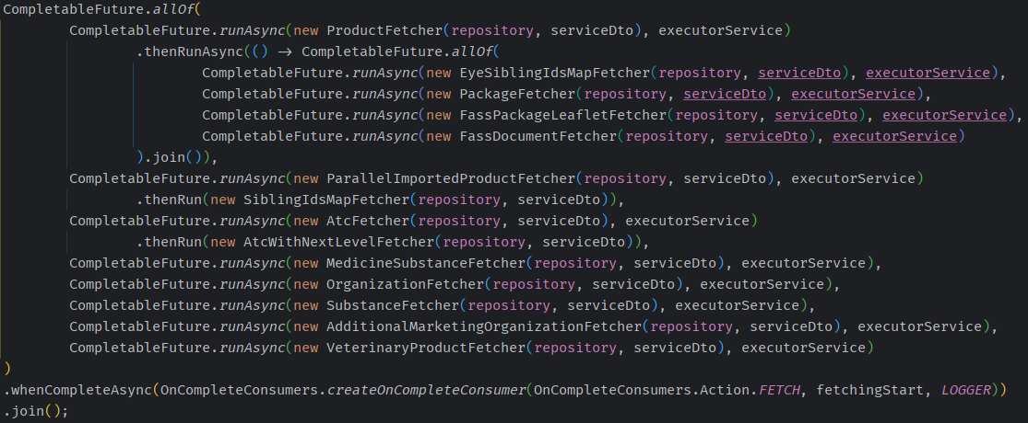
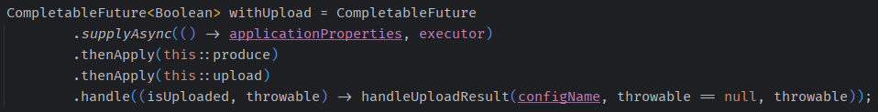
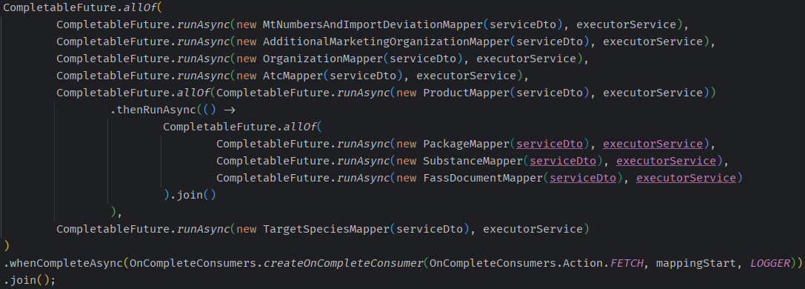
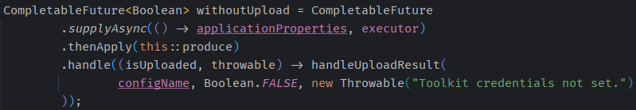
Java concurrent - CompletableFuture

Slide 52
Paweł Gawędzki
pawg@netcompany.com

